Slide 1
Design Concepts and Principles

Slide 2
Analysis to Design
D
a
t
a
O
b
j
e
c
t
D
e
s
c
r
i
p
t
i
o
n
P
r
o
c
e
s
s
S
p
e
c
i
f
i
c
a
t
i
o
n
(
P
S
P
E
C
)
p
r
o
c
e
d
u
r
a
l
d
e
s
i
g
n
E
n
t
i
t
y
-
D
a
t
a
F
l
o
w
R
e
l
a
t
i
o
n
s
h
i
p
D
i
a
g
r
a
m
D
i
a
g
r
a
m
i
n
t
e
r
f
a
c
e
D
a
t
a
D
i
c
t
i
o
n
a
r
y
d
e
s
i
g
n
a
r
c
h
i
t
e
c
t
u
r
a
l
d
e
s
i
g
n
S
t
a
t
e
-
T
r
a
n
s
i
t
i
o
n
D
i
a
g
r
a
m
d
a
t
a
C
o
n
t
r
o
l
S
p
e
c
i
f
i
c
a
t
i
o
n
(
C
S
P
E
C
)
d
e
s
i
g
n
THE ANALYSIS MODEL
THE DESIGN MODEL

Slide 3
Design Principles
The design process should not suffer from ‘tunnel vision.’
The design should be traceable to the analysis model.
The design should not reinvent the wheel.
The design should “minimize the intellectual distance” [DAV95] between the software and the problem as it exists in the real world.
The design should exhibit uniformity and integration.
The design should be structured to accommodate change.
The design should be structured to degrade gently, even when aberrant data, events, or operating conditions are encountered.
Design is not coding, coding is not design.
The design should be assessed for quality as it is being created, not after the fact.
The design should be reviewed to minimize conceptual (semantic) errors.
From Davis [DAV95]

Slide 4
Fundamental Concepts
Abstraction—data, procedure, control
Refinement—elaboration of detail for all abstractions
Modularity—compartmentalization of data and function
Architecture—overall structure of the software
  Structural properties
  Extra-structural properties
  Styles and patterns
Procedure—the algorithms that achieve function
Hiding—controlled interfaces

Slide 5
Data Abstraction
door
manufacturer
model number
type
swing direction
inserts
lights
type
number
weight
opening mechanism
implemented as a data structure

Slide 6
Procedural Abstraction
open
details of enter
algorithm
implemented with a "knowledge" of the
object that is associated with enter

Slide 7
Stepwise Refinement
open
walk to door;
reach for knob;
open door;
repeat until door opens
turn knob clockwise;
walk through;
if knob doesn't turn, then
close door.
take key out;
find correct key;
insert in lock;
endif
pull/push door
move out of way;
end repeat

Slide 8
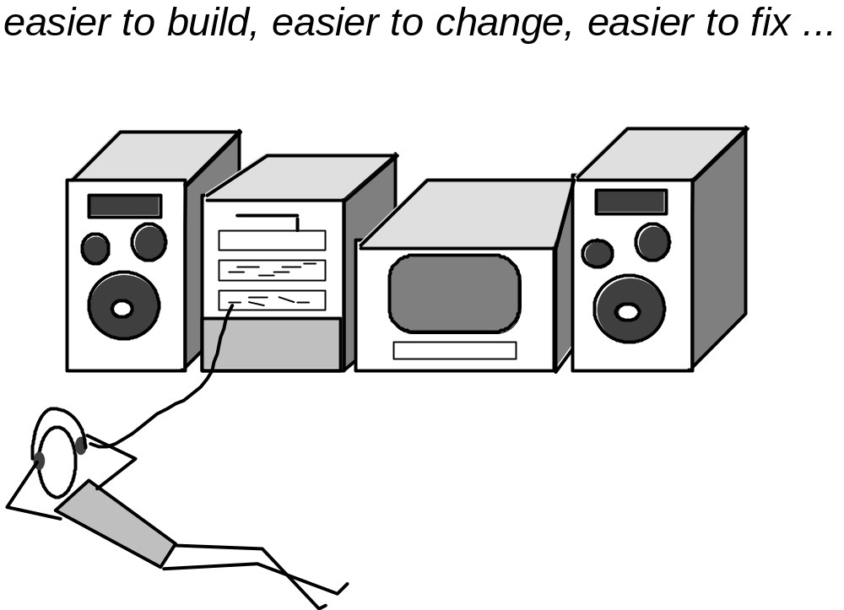
Modular Design

Slide 9
Modularity: Trade-offs
What is the "right" number of modules
for a specific software design?
module development cost
cost of
software
module
integration
cost
optimal number
number of modules
of modules

Slide 10
Architecture
“The overall structure of the software and the ways in which that structure provides conceptual integrity for a system.” [SHA95a]
Structural properties. This aspect of the architectural design representation defines the components of a system (e.g., modules, objects, filters) and the manner in which those components are packaged and interact with one another. For example, objects are packaged to encapsulate both data and the processing that manipulates the data and interact via the invocation of methods .
Extra-functional properties. The architectural design description should address how the design architecture achieves requirements for performance, capacity, reliability, security, adaptability, and other system characteristics.
Families of related systems. The architectural design should draw upon repeatable patterns that are commonly encountered in the design of families of similar systems. In essence, the design should have the ability to reuse architectural building blocks.

Slide 11
Control Hierarchy
Program Structure, represents the organization of program components(modules) and implies a hierarchy of control.
NO concern to procedural aspects of software

Slide 12
EXECUTIVE
Fan out
Depth
MODULE A
MODULE B
MODULE C
MODULE D
MODULE E
MODULE F
MODULE G
Module X
Module Y
Module Q
Module R
Module M
Module N
Fan in
Module K
Module L
Module S
Breadth

Slide 13
Major Concepts
Depth
Width
Fan-in
Fan-out
Super ordinate
Sub ordinate
Visibility
Connectivity

Slide 14
Information Hiding
module
• algorithm
controlled
interface
• data structure
• details of external interface
• resource allocation policy
clients
"secret"
a specific design decision

Slide 15
Why Information Hiding?
reduces the likelihood of “side effects”
limits the global impact of local design decisions
emphasizes communication through controlled interfaces
discourages the use of global data
results in higher quality software

Slide 16
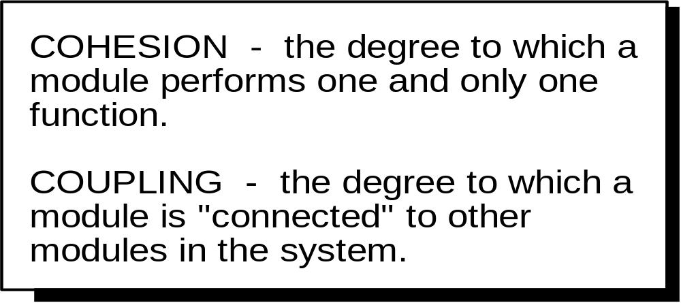
Functional Independence

Slide 17
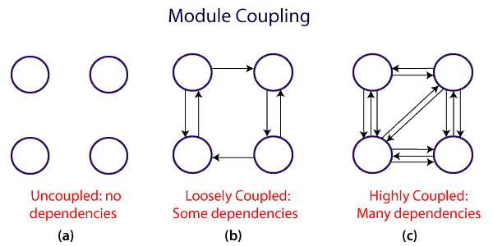

Slide 18
Cohesion
A natural extension to information hiding
A cohesive module should (ideally) do just one thing
High cohesion should be achieved and low cohesion should be avoided

Slide 19
Low Cohesion
Coincidently Cohesive
  A module having set of tasks that relate to each other loosely
Logical Cohesive
  A module performs tasks that are logically cohesive
Temporal Cohesive
A module having set of tasks that must be executed with the same span of time.

Slide 20
Moderate Cohesion
Procedural Cohesion
Processing elements of a module are related and must be executed in a specific order.
Communicational Cohesion
All processing elements concentrate on one area of a data structure

Slide 21
High Cohesion
It is characterized by a module that performs one distinct procedural task
Nutshell:
Most Importantly, it is unnecessary to determine the precise level of cohesion, Rather it is important to strive for high cohesion and recognize low cohesion so that software design can be modified to achieve greater functional independence.

Slide 22
Coupling
A measure of interconnection among modules in a software structure
Coupling depends on:
      Interface Complexity between modules
      Entry Point
      Data that is passed across the interface
We strive for low coupling ideally

Slide 23
Loose Coupling
Data Coupling
    No direct relationship between modules
    Simple data is passed
Stamp Coupling
    A portion of data structure is passed via a module interface

Slide 24
Moderate Coupling
Characterized by passage of controls between modules
A control flag is passed between modules

Slide 25
High Coupling
Occur when modules are tied to an environment external to software
Content Coupling
  Occurs when one module makes use of data or control information maintained within the boundary of another module

